Slide 1
An usual case
65 year old male
Weakness, falling, no fracture
History of coronary artery disease
DXA scans: Lumbar Spine BMD T = -2.3; Total hip BMD T = -2.4
Treatment for osteopenia: Calcium 1000 mg, Vitamin D3 400 IU
Labs:
Calcium: 9.1 mg/dL;
PTH: 68 pg/ mL ( 10-70)
25OHD: 14 ng/mL
What next ?
Is this vitamin D okay ?
Does it need supplementation ?
Few years back this level was normal
Now, everyone is speaking on higher levels of vitamin D as normal.

Slide 2
Some more cases !
28 weeks pregnancy. GDM. Hypothyroid. Back ache. History of Preeclampsia during past pregnancy.
Calcium related tests: - 25OHD very low !
8 months young girl child. History of irritability. Recent seizure. On Inv – Cal Low. History of breast feeding only. No top feed.
Vitamin D in pregnancy ?
Is it important ??
Now, everyone is speaking too much on vitamin D ?
Vit D fanatic doctors !!!

Slide 3
VITAMIN D
Back to Some Basics
Monashis Sahu
MD (Medicine), DM (Endocrinology)
Consultant Endocrinologist
VIMHANS, MAX, ADIVA
New Delhi

Slide 4
Basic Points to Cover
Basic Physiology and pathology before its use
Basics of definition and cut offs
Where and in whom to use? Who is deficient in vitamin D ?
How to treat or prevent deficiency ?

Slide 5
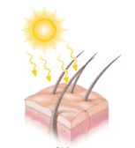
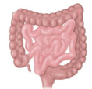
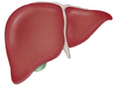
Source and synthesis of vitamin D
VITAMIN D from diet
GUT
SKIN
7 dehydrocholestrol
VITAMIN D₃
VITAMIN D₂
THE MAJOR CIRCULATING FORM
25(O
H) D
T 1/2 = TWO to THREE WEEKS
PTH / Low Phosphorus
Calcium
THE BIOACTIVE FORM
1,25 (OH)₂ D₃
T 1/2 = SIX HOURS

Slide 6
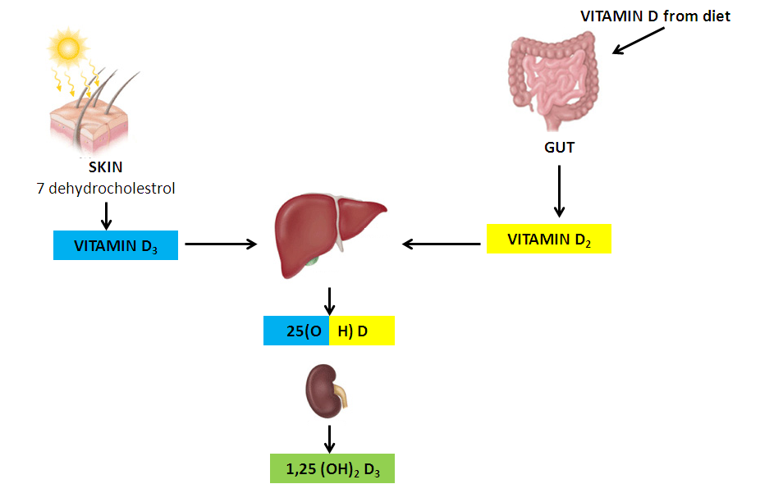
WHAT’S IN A NAME !
SOURCE:
Vitamin D₃: From animal Source
Vitamin D₂: From Plant Source
VITAMIN D₃
VITAMIN D₂
COMMERCIAL PREPARATION: Vitamin D₃: UV Irradiation of 7 dehydrocholestrol from Lanolin
Vitamin D₂: UV Irradiation of ergosterol from yeast
What we measure in Labs ? :
Both – Vitamin D₃ and Vitamin D₂
25(OH)D measured =
25(OH)D₂ + 25(OH)D₃
Both have EQUIVALENT BIOLOGICAL ACTIVITY

Slide 7
WHERE DOES VITAMIN D ACT ??
1, 25 (OH)₂ D₃ binds to Vitamin D Receptor (VDR) present in many tissues:-
Intestine : Helps increase calcium absorption
Bone osteoblasts: Skeletal integrity
Without Vitamin D only 10-15 % of calcium is absorbed
One can also get vitamin D from SUN exposure
Notes:
Parathyroid cells: Antiproliferative effect on paratyroid
Treatment and prevention of hyperparathyroidism associated with renal insufficiency
Keratinocytes
Some cancer cells

Slide 8
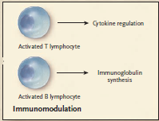
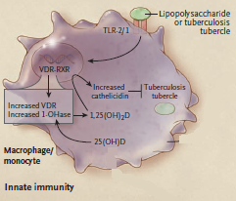
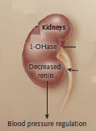
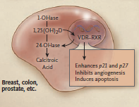
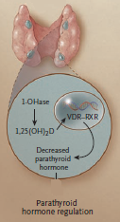
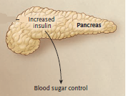
Hollick et al. NEJM
BLOOD PRESSURE
IMMUNITY
NON SKELETAL FUNCTIONS OF VITAMIN D
PARATHYROID
CANCER CELLS
DIABETES
Notes:
Hollick et al. NEJM

Slide 9
ROLE OF VITAMIN D IN HEALTH
SKELETAL HEALTH
NON - SKELETAL HEALTH
THUS NEED AN OPTIMAL LEVEL

Slide 10
Definition of Vitamin D sufficiency
More than 20 ng/mL ???
More than 30 ng/mL = Sufficient !
PTH:
Vitamin D low ---- PTH rises
PTH levels reaches its nadir when 25(OH)D > 30-40 ng/mL
Calcium absorption:
Without vitamin D only 10-15 % of dietary Ca absorbed
When 25(OH)D increases from 20 to 32 ng/mL, Intestinal Calcium transport increased by 45 to 65 %
BMD:
Maximum Density achieved when 25(OH)D > 40 ng/mL
Vitamin D intoxication : > 150 ng/mL

Slide 11
Vitamin D – and in health

Slide 12
CLINICAL MANIFESTATIONS of VITAMIN D DEFICIENCY
Usually a consequence of impaired intestinal calcium absorption
Long standing vitamin D deficiency:
Hypocalcemia
Rarely any problem
Acute Intercurrent illness – Acute symptoms can occur
Recent development of hypomagnesemia
Use of potent bisphosphonates
Secondary rise in PTH
Impaired mineralization of skeleton (Rickets/ Osteomalacia); Low BMD
Muscle: Proximal Myopathy

Slide 13
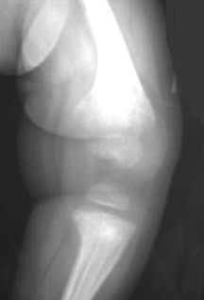
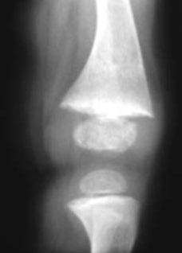
RICKETS AND OSTEOMALACIA
RICKETS : Expansion of growth plate before epiphysis fusion
OSTEOMALACIA : Impaired mineralization of bone matrix
Biomechanically inferior
Bowing of weight bearing extremities
Fractures
Knee joint
Before treatment
Knee joint
After 9 months treatment
Borrowed photos

Slide 14
Treatment and Prevention Strategies
Age | Treatment | Maintainance
0-1 yr | 2000 IU/day. OR 50,000 units/ week x 6 weeks | 400-1000 IU/day
1-18 yrs | 2000 IU/day. OR. 50,000 units/week x 6 weeks | 600-1000 IU/day
All Adults | 6000 IU/day. OR. 50,000 units/week x 8 weeks | 1500-2000 IU/day
For every 100 IU of vitamin D3 serum 25(OH)D increases by 0.7 – 1.0 ng/mL
Enoocrine Society Clinical Practice Guideline. JCEM 2011
Notes:
In obese patients, patients with malabsorption syndromes, and patients on medications affecting vitaminD metabolism, a higher dose (two to three times higher; at least 6000–10,000 IU/d) of vitamin D is suggested.
Serial monitoring of 25(OH)D levels and serum calcium levels during treatment with vitamin D to prevent hypercalcemia.
For patients with primary hyperparathyroidism and vitamin D deficiency, treatment with vitamin D as needed, is suggested. Serum calcium levels should be monitored.

Slide 15
Recommended Dietary Intake
Age Group | Daily intake IU/day | Intake to raise 25(OH)D > 30 ng/mL | Maintainance tolerable upper limit
0-1 yr | 400 | 1000 | 1000 (upto 6mths) 1500 (6-1 yr)
1-18 yrs | 600 | 1000 | 2500 (1-3yrs) 3000 (4-8 yrs) 4000 (> 8 yrs)
19-50 | 600 | 1500-2000 | 4000
50-70 | 600 | 1500-2000 | 4000
70 + | 800 | 1500-2000 | 4000
Pregnant/ lact | 600 | 1500-2000 | ?
NON - SKELETAL HEALTH BENEFITS
SKELETAL HEALTH BENEFITS
Enoocrine Society Clinical Practice Guideline. JCEM 2011
Notes:
Obese children and adults and children and adults on anticonvulsant medications, glucocorticoids,
antifungals such as ketoconazole, and medications for AIDS be given at least two to three times more vitamin D for their age group to satisfy their body’s vitamin D requirement
Higher levels of 2000 IU/d for children 0–1 yr, 4000 IU/d for children 1- 18yr,and10,000IU/d for children and adults19yr an dolder may be needed to correct vitamin D deficiency

Slide 16
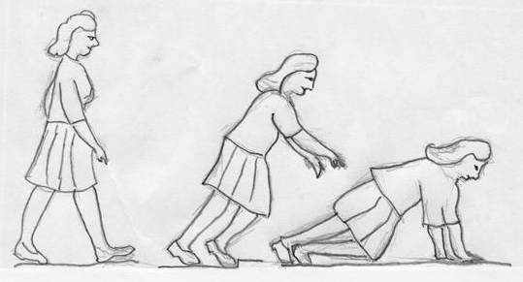
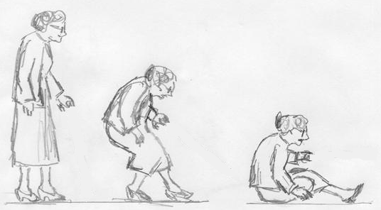
VITAMIN D IN OSTEOPOROSIS
3270 elderly French women : 1200 mg of Calcium daily + 800 IU Vit D daily x 3 years. Reduced risk of hip fracture by 43 %
Proximal muscle strength improved
400 IU per day was not effective in reducing fall
800 IU per day plus Calcium: Reduced risk of falls by 22 to 72 %
Notes:
The cartoon is taken from google. It stated “Figure 6. Difference between a simple fall in a younger person (above) and in an elderly (below). Modification from Cummings & Nevitt 1989, drawn by Anja Partanen.”

Slide 17
USE IN OSTEOPOROSIS
Optimal prevention of non vertebral and hip # only in trials providing 700 to 800 IU per day in patients whose baseline 25(OH)D was less than 17 ng/mL and whose 25(OH)D concentration rose to 40 ng/mL
Hollick. NEJM 2007

Slide 18
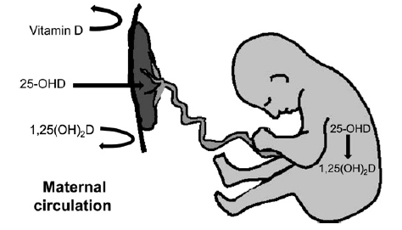
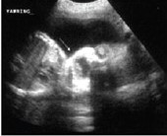
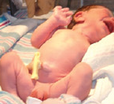
USE in PREGNANCY
800 to 4,000 i.u per day has been shown to be effective in recent trials.
India: 1.2 lac units each in second and third trimester (V Bhatia’s group, SGPGI, Lucknow)
Pre eclampsia
GDM
Infection
SGA
Rickets
Neonatal hypocalcemia

Slide 19
SUMMARY – where to use how to use

Slide 20
USING VITAMIN D IN PRESENT SCENARIO
Limited Sun Exposure
Pregnant women
Drugs: Phenytoin
Malabsorption
STRATIFY RISKS
NO RISK FACTORS
RISK FACTORS PRESENT
Ensure 600- 800 IU per day
No need for screening
25 (OH) D < 20 ng/mL
DEFICIENCY
25 (OH) D : 20 -30 ng/mL
INSUFFICIENCY
PHILOSOPHY
REPLETE
SUPPLEMENT
60,000 i.u per week x 6-8 weeks, followed by
At least 800 i.u daily
At least 800 i.u daily
REGIMEN
CHOICE OF TREATMENT
Cholecalciferol THE CHOICE. Injectable may be used where compliance / absorption issues . Avoid Calcitriol (half life only 6 hours, risk of hypercalcemia in some).
Pregnancy: At least 60,000 i.u. every month during third trim.
Preferably start replacing early . 600 – 4000 i.u daily is safe
SPECIAL SITUATIONS
Malabsorption: Need higher dose.
Use calcitriol in renal failure, Severe Liver Disease

Slide 21
PREVENTING AND TREATING
DON’T IGNORE THE SUN

Slide 22
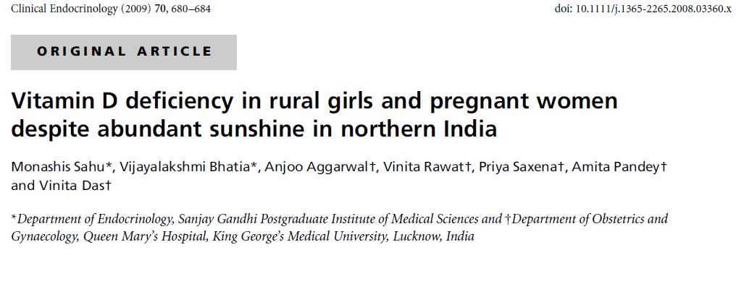
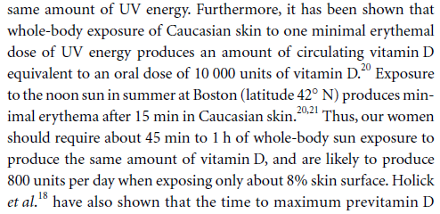

Slide 23
SENSIBLE SUN EXPOSURE ALL THAT WAS REQUIRED !!

Slide 24
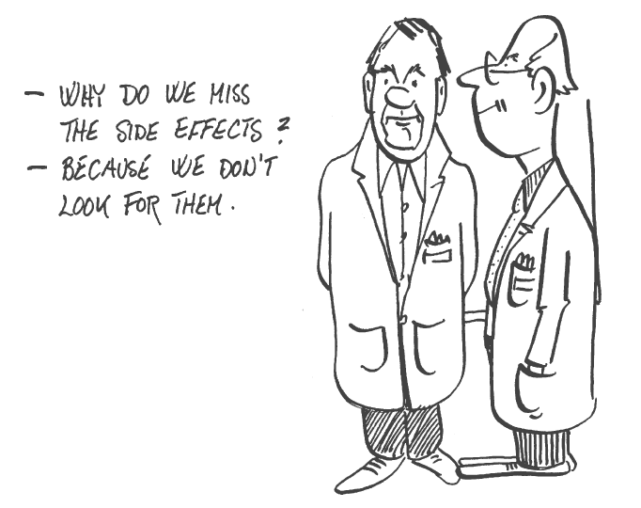
LASTLY…….. WORD OF CAUTION. DON’T OVERTREAT
SEVEN CASES OF VITAMIN D TOXICITY AND HYPERCALCEMIA IN PAST 12 MONTHS
Singular free lance experience

Slide 25
Thank You ☺
sahu.monashis@gmail.com

Slide 26
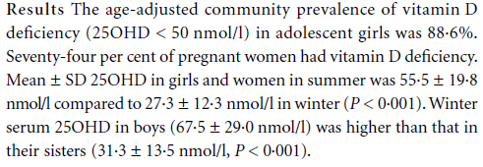

Slide 27
HOW TO MONITOR ?
Normocalcemia is observed within one week of therapy
PTH normalization may take 3 – 6 months
24 hours urinary calcium
Range: 100- 250 mg / 24 hours
Low levels: Compliance issue to vitamin D – Calcium or absorption issues
Higher levels: Reduce vitamin D or calcium supplementation

Slide 28
PREVENTING AND TREATING VITAMIN D DEFICIENCY
What is Minimum ?
Daily intake of 400 IU: Sometimes insufficient to prevent vitamin D deficiency !!!!!
800 IU daily: Decreases risk of Hip # in elderly
What is Maximum ?
Safety margin for vitamin D is large
Toxicity only if > 40,000 IU daily
Regimen for treating deficiency
Pharmacological replacement 50,000 IU daily x 3 – 12 weeks.
Follow it up with maintenance of 800 IU daily
Pharmacological dose for maintainance if on barbiturates or phenytoin
Intestinal malabsorption: - 250000 IU IM twice yearly

Slide 29
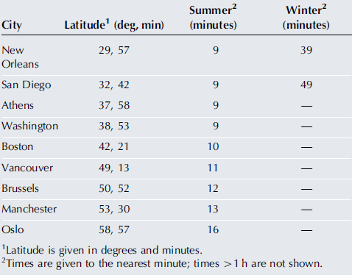
SUN SHINE AND VITAMIN D
Estimated time taken to acquire the same vitamin D-weighted dose as used in this study, at
different North American and European locations at local noon on June 21 and December 21.
Such exposure led to > 20 ng/mL but not the required 32 ng/mL
Rhodes et al., Journal of Investigative dermatology. 2010

